Slide 1
CS61B Discussion 2
Classes, Pass-by-Value, Static

Slide 2
Administrivia
Lab 1 and Lab 2 due this Friday 2/1 at midnight.
Proj0 NBody also due Friday 2/1 at midnight.
  If you haven’t started please start ASAP!
One-on-one tutoring will be made available the week of Feb. 3rd! We’ll announce details soon.
We’re sending out weekly announcements! Check out this week’s @346
Office hours, LOST and exam prep sections start this week! See Piazza post @346 for more info.

Slide 3
What are we doing today?
Review
  Class definition, primitives and reference, box and pointer, static, intlists
Questions
  Will get through 1, 2, 3
  Likely won’t get to 4

Slide 4
Review: Defining classes
// class definition
public class IntList {
// instance variables
int head;
IntList tail;
// constructors, which will create IntList objects
public IntList() {...}
public IntList(int value, IntList tail) {...}
// you can create methods that use the instance variables!
public void insert(int val) {...}
public void removeLast() {...}
}

Slide 5
Review: Primitives and Reference
Primitives:
byte, short, long, int, double, float, char, boolean
References:
Everything else!
Objects, arrays, Strings, etc.
Golden Rule of Equals AKA pass-by-value
When you do “a = b”, you always copy the bits of b into a.
For primitives: Directly copy the value inside b to a.
For Reference types: Copy the memory address of b into a.
  Also can say “copies the pointer in b to a”

Slide 6
Review: Box and Pointer Diagrams
Box and Pointers are the 61B equivalent of 61A’s environment diagram
They are crucial to helping us keep track of what goes on in a program: use them!
We didn’t specify what integers are going in the array, so Java initializes it with the default value 0
int x = 29;
int[] arr = new int[3];
Int x
arr
x
int[ ] arr
29
0
0
0
29
Primitives go in the box
Reference types are referenced via pointers

Slide 7
Review: Static
Public class Dog {
public int legs;
public static String name = “Doge”;
public static void bark() {...}
public static void main(String[] args) {
Dog fido = new Dog();
}
}
Static variables are shared by all instances of the class and should be accessed via dot notation with the class, not the instance.
  Dog.name instead of fido.name
Static methods are methods that do not require an instance to call it, and thus do not access any instance variables.
  Dog.bark();
You can call static methods on an instance, but what will happen is Java will actually look for the static type of the object and run the method from that class.
Dog g = new Dog();
g.bark();
=
Dog g = new Dog();
Dog.bark();

Slide 8
Review: IntLists
IntLists are the equivalent of 61A’s “Linked List” with one restriction: it can only hold integers.
Each IntList consists of 2 elements:
  an integer first
  an IntList rest
IntList first rest
1
2
3

Slide 9
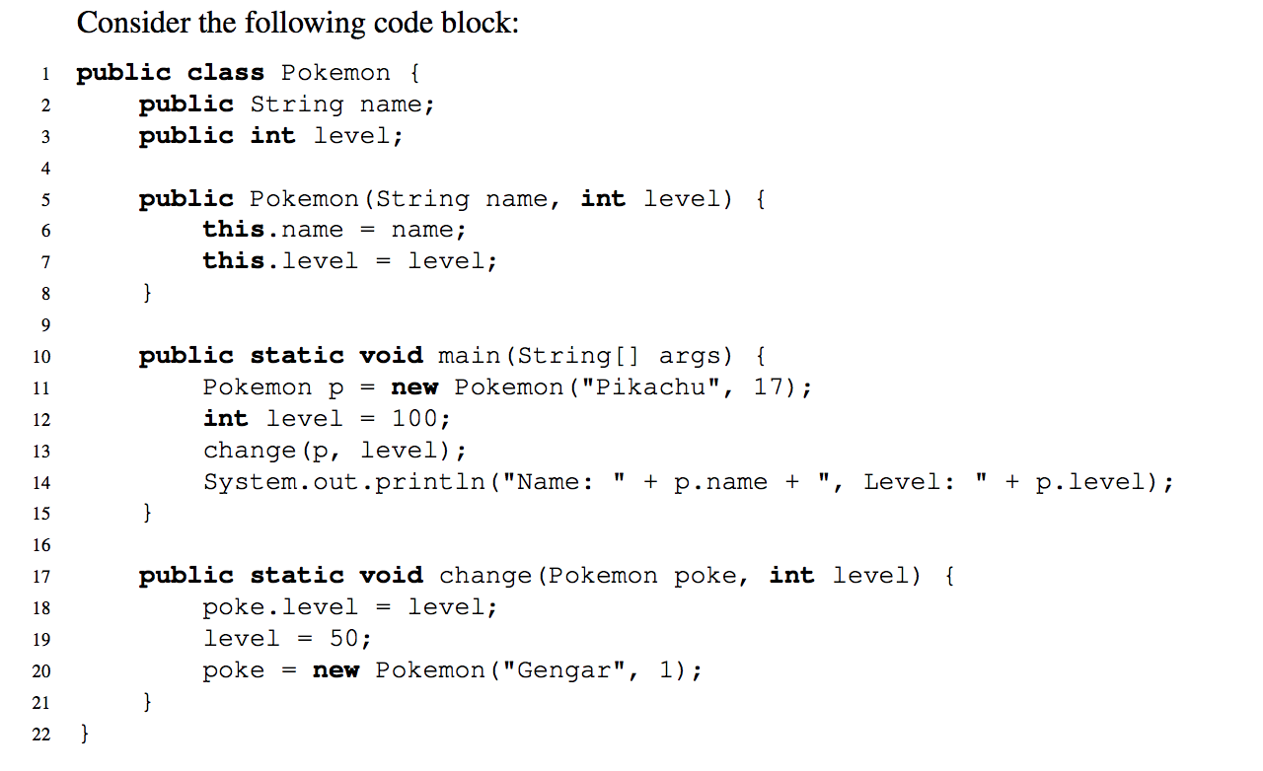
Pass by What?
Notes:
What does Java visualize after running the main block?

Slide 10
Pass by What?
What would Java display?
  Name: Pikachu, Level: 100
What does the Box and Pointer look like after Java evaluates the main method?
  Java Visualizer
On line 19, we set level equal to 50. What level do we mean? An instance variable of the Pokemon class? The local variable containing the parameter to the change method? The local variable in the main method? Something else?
  It is the local variable in the change method and does not have any effect on the other variables of the same name in the Pokemon class or the main method.

Slide 11
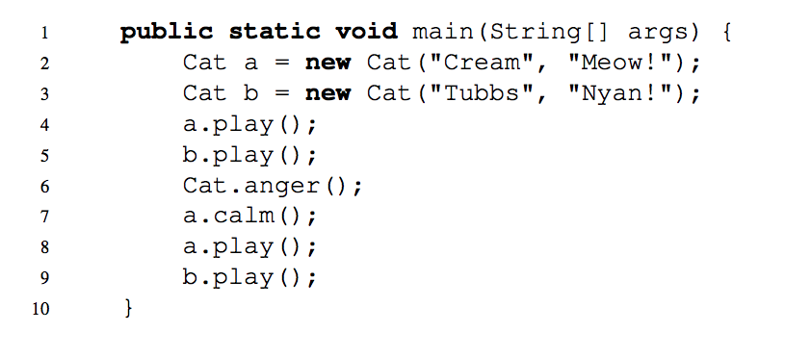
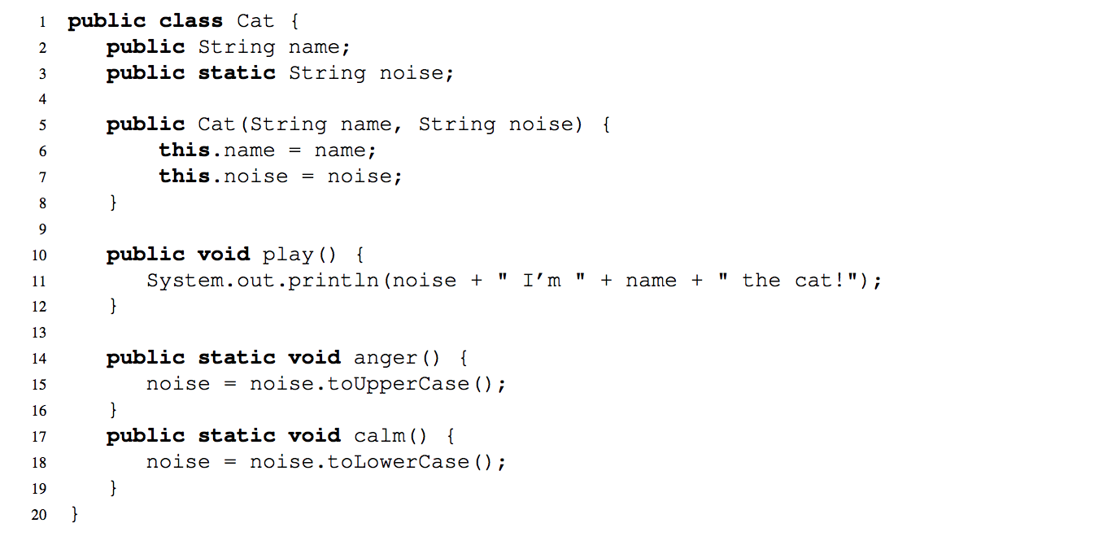
2.) Static Methods and Variables
Java Visualizer
Detailed explanation is also on the discussion solution!
Notes:
What is printed when the main function is run?

Slide 12
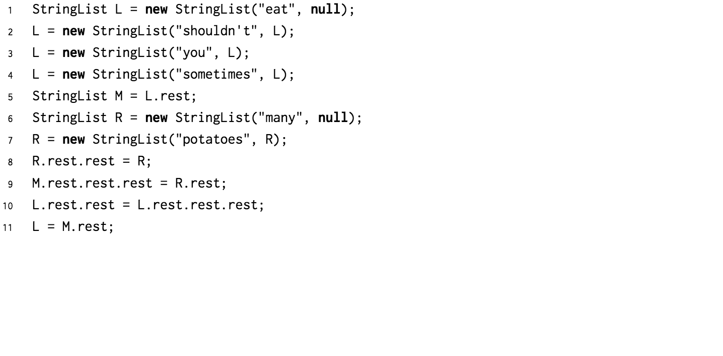
3.) Practice with Linked Lists
Java Visualizer

Slide 13
4.) Extra: Squaring a List
Components of recursion:
Base case
Recursive call
Assuming the recursive call works, how can we use it?

Slide 14
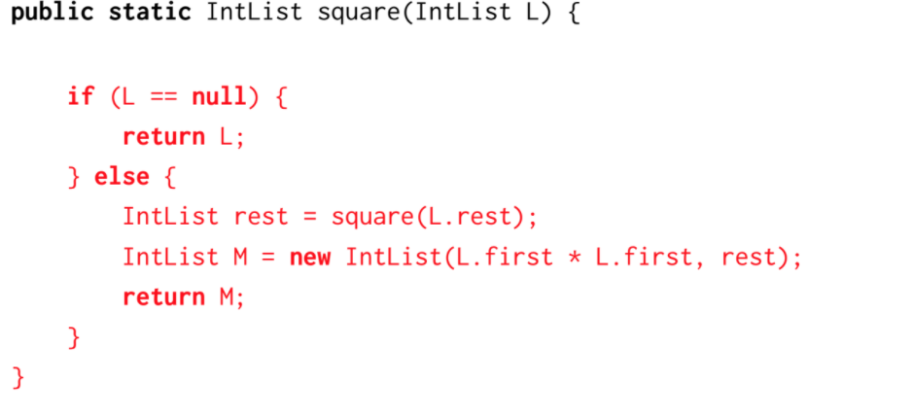
4.) Extra: Squaring a List
Components of recursion:
Base case
Recursive call
Assuming the recursive call works, how can we use it?

Slide 15
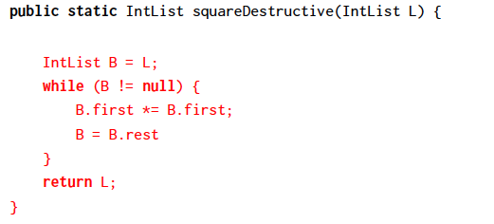
4.) Extra: Squaring a List
Components of recursion:
Base case
Recursive call
Assuming the recursive call works, how can we use it?

